Slide 1



Name Financial Review
June 2024

Slide 2

Agenda
Personal & Planning Update
Financial Well-being Progress Report
Retirement Goals & Check In
Market Outlook
Our Strategy

Slide 3


Personal update
To make today’s meeting worthwhile, you would like to cover:
Today we will be addressing your worries and concerns regarding:
What’s gone well since we last spoke?
What’s been keeping you busy lately?
What’s changed in your life (and your family’s lives) since we last spoke?
Any changes to your health or your family's health?
Any new financial goals?
How would you prefer to receive a copy of this Financial Review?

Slide 4

Information review Client 1 name
Are there any changes to the information below?
Best phone #:
Address:
Email address:
Employer and title:
Employer location:
Length of time at job:
Current income:
BCDL:
KYC UPDATE REQUIRED:

Slide 5
Information review Client 2
Are there any changes to the information below?
Best phone #:
Address:
Email address:
Employer and title:
Employer location:
Length of time at job:
Current income:
BCDL:
KYC UPDATE REQUIRED:

Slide 6

Personal contact Client 1 name DELETE IF NO KYC REQUIRED
TCP:
TCP Relationship to Client:
TCP Email or Phone #:
Assets combined with spouse?

Slide 7
Personal contact Client 2 name
TCP:
TCP Relationship to Client:
TCP Email or Phone #:
Assets combined with spouse?

Slide 8

Contact preferences
What is your preferred form of communication?
Telephone email text
How often do you want us to meet?
Quarterly semi- annually annually
What is your preferred way to meet?
In person zoom no preference
Are you signed up for client portal access?
Yes No I would like assistance
Are you signed up for our monthly newsletter?
Yes No I would like assistance

Slide 9

YOUR Financial team
Taxes:
Legal updates:
Banking:
Loans, lines of credit, mortgages:
Life, Disability & Critical Illness Insurance:

Slide 10

Net worth Table

Slide 11
Net worth Chart

Slide 12
YOUR FINANCIAL GOALS
Save for Retirement
Plan for your Estate
Minimize Taxes
Help Aging Parents
Reduce Interest Costs
Educate Your Children Financially
Eliminate Financial Stress
Purchase Investment Property
Provide for Children or
Grandchildren's Education
Protect Family from
Unforeseen Events
Pay off Mortgage
Invest Your Money Ethically
Ensure You Don’t Outlive
Your Retirement Income
Provide regular income from investments
Educate Yourself Financially
Help Children Financially
Donate Regularly to Charity
Leave a Legacy for your family

Slide 13




Financial WELL-BEING CHECK IN
Retirement plan
Tax
planning
Family
protection
Estate preservation
Notes:
Notes:
Notes:
Notes:

Slide 14


Retirement projection
Home | Retirement Projections

Slide 15
Tax planning- 2024 Tax Rates
2024 Taxable Income | Income or Interest Income | Capital Gains | Eligible Dividends | Non Elig Dividends
first $47,937 | 20.06% | 10.03% | -9.60% | 10.43%
over $47,938 up to $55,867 | 22.70% | 11.35% | -5.96% | 13.47%
over $55,868 up to $95,875 | 28.20% | 14.10% | 1.63% | 19.80%
over $95,876 up to $110,076 | 31.00% | 15.50% | 5.49% | 23.02%
over $110,077 up to $111,733 | 32.79% | 16.40% | 7.96% | 25.07%
over $111,734 up to $133,664 | 38.29% | 19.15% | 15.55% | 31.40%
over $133,665 up to $173,205 | 40.70% | 20.35% | 18.88% | 34.17%
over $173,206 up to $181,232 | 44.02% | 22.01% | 23.46% | 37.99%
over $181,233 up to $246,752 | 46.12% | 23.06% | 26.36% | 40.41%
over $246,752 up to $252,752 | 49.80% | 24.90% | 31.44% | 44.64%
over $252,752 | 53.50% | 26.75% | 36.54% | 48.89%

Slide 16
Family protection
 | Coverage through work | Private Insurance | Gap in coverage (-/+)
Life insurance
Disability insurance
Critical illness
Insurance review? ☐
Leslie will contact you with a link to set up a meeting

Slide 17
Estate preservation
 | Yes/No | Last Updated | Executor | Beneficiaries | Where is a copy
Do you have a will?
POA
Representation Agreement

Slide 18
Estate preservation
 | Beneficiary (Yes/No) | Jointly Owned | Subject to Probate | Subject to Income Tax through Estate
RRSPs, RRIFs, |  | n/a | Not with beneficiary | Yes on final death
TFSAs |  | n/a | Not with beneficiary | No
Non Reg investments |  |  | Not if jointly owned | Will be ‘deemed sold’
Real Estate |  |  | Not if jointly owned | Principal residence – no; others yes
Bank Accounts |  |  | Not if jointly owned | No
Life Insurance |  |  | Not with beneficiary | No

Slide 19
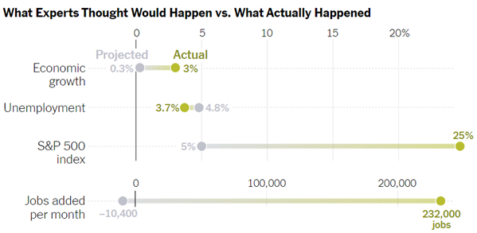
FORECASTING IS HARD
S&P 500 Sell Side Strategist Beginning of the Year Consensus Forecast vs Actual
 | Forecast | Actual
2019 | 19% | 29%
2020 | 3% | 16%
2021 | 7% | 27%
2022 | 4% | -19%
2023 | 5% | 25%
2024 | 1% | N/A

Slide 20
2024 Investment outlook
Global Economy – slowing down into possible recession (50/50 chance). US economy still growing. So far avoiding recession.
Equity Markets – prices are closer to long term averages but could have more volatility until clarity about economic slowdown/governments pause on interest rate increases.
Fixed Income – good due to lower prices and higher yields.
Interest rates – US and Canadian government are decreasing rates. Inflation is coming down
Long Term – we invest to reach out long term financial goals. If you are patient and flexible, you’ll be rewarded in end

Slide 21
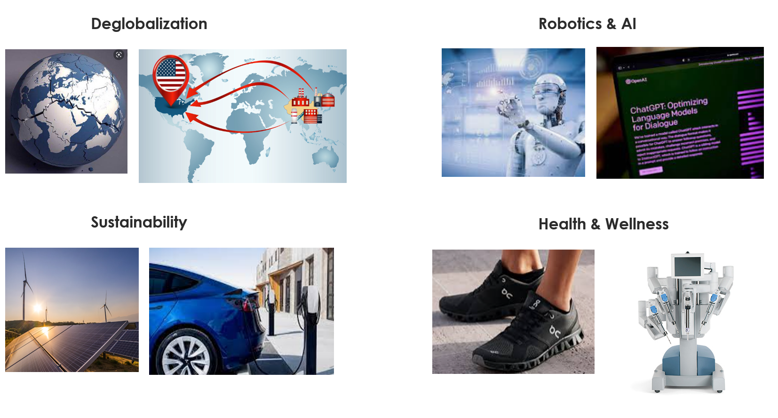
Today’s longer-term growth opportunities

Slide 22
CORRECTIONS ARE NORMAL
Stock market corrections are very common and very difficult to predict. Since 1980, the S&P 500 index has fallen an average of ~14.0% in any given calendar year but is positive 75% of the time with an average return of ~10.0%
S&P 500 Index - Calendar Year and Max Intra - Year Returns (1980 - current)
40% 34%
31%
30%
_{30%} 26% 26% ^{27%} 26%
27%
26%
29%
27%
24%
20%
20%
23%
19%
20%
10%
0%
-10%
-20%
-30%
-40%
-50%
-60%
_{15%}17%
15%
14%
13%
16%
12%
9%
13%
11%
10%
_{4%}7%
3%
4%
1%
2%
-19%
-2%_{-3%}
0%
-1%
-3%
-10%
-7%
-8%-9%
_{-8%-8%}-7%-6%-6%-5%
-9%
-8%
-10%
-8%-7%-8%_{-10%}
-6%-6%
-6%_{-7%}
-5%
-13%
-11% -12% -13% _{-14%}
-10%
-12%-11%
-10%
-17%-18%-17%
-20%
_{-19%} -17% _{-23%}
-16%_{-19%}
-20%
-30%
-28%
-25%
-34% -34% -34%
-38%
-49%
Calendar Year Return
Max Intra-Year Drawdown
Source: Bloomberg, Manulife Investment Management, Capital Markets Strategy. As of December 31, 2023

Slide 23
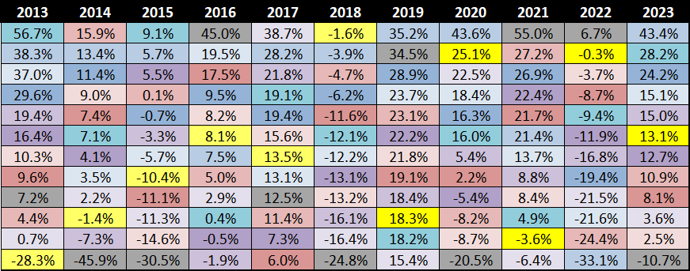
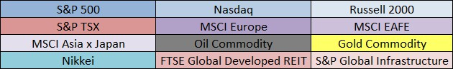
VARIOUS EQUITY INDICES ANNUAL RETURNS BY CALENDAR YEAR
Source: Bloomberg, Manulife Investment Management, Capital Markets Strategy. As of December 31, 2023

Slide 24
Investment results
Market Returns | 2024 YTD | 2023 | 2022 | 2021 | 2020 | 2019
TSX (Canadian Index) | 6% | 8.1% | -8.7% | 21.7% | 2.2% | 19.1%
S&P500 (US index) | 16.1% | 24.2% (20.9% Can) | -19.4% | 26.9% (26% Can) | 16.3% (13.9% Can) | 28.9% (22.8% Can $)
Can Bonds | -.8% | 5.7% | -11.7% | -2.5%
Your Returns

Slide 25

Our strategy
STAYED
INVESTED
REMAIN
DIVERSIFIED
STOCKS
FIXED
INCOME
CASH
USE
ALTERNATIVES
OUR FINANCIAL PLAN
USE MANAGERS THAT ARE FLEXIBLE, GLOBAL & EXPERIENCED and dividend stocks
Use global managers, can use GICs
KEEP IN PORTFOLIO ESPECIALLY FOR RESP & RETIREMENT Withdrawals
MORTGAGE INVESTMENTS, INFRASTRUCTURE, PRIVATE INVESTMENTS
FOCUS ON YOUR GOALS

Slide 26
Investment Growth

Slide 27
Investment Summary

Slide 28
Your Investment Risk & objectives
Account | Objective | Risk Profile | Purpose of Account | Time Horizon
RRSP | 100% growth | 100% medium risk
TFSA
NON REG

Slide 29
RRIF withdrawals
Account | Monthly Amount | Taxes Withheld and % | Date | Amount deposited
RRIF
RRIF
RRIF

Slide 30
Asset allocation 2024
Y Charts Review

Slide 31
YOUR FINANCIAL GOALS
Save for Retirement
Vacation Planning
Secondary Home
Education
Pay off Mortgage

Slide 32




PERSONAL FINANCIAL action plan
Retirement goals
Tax planning
Family protection
Estate preservation
Homework:
Homework:
Homework:
Homework:

Slide 33
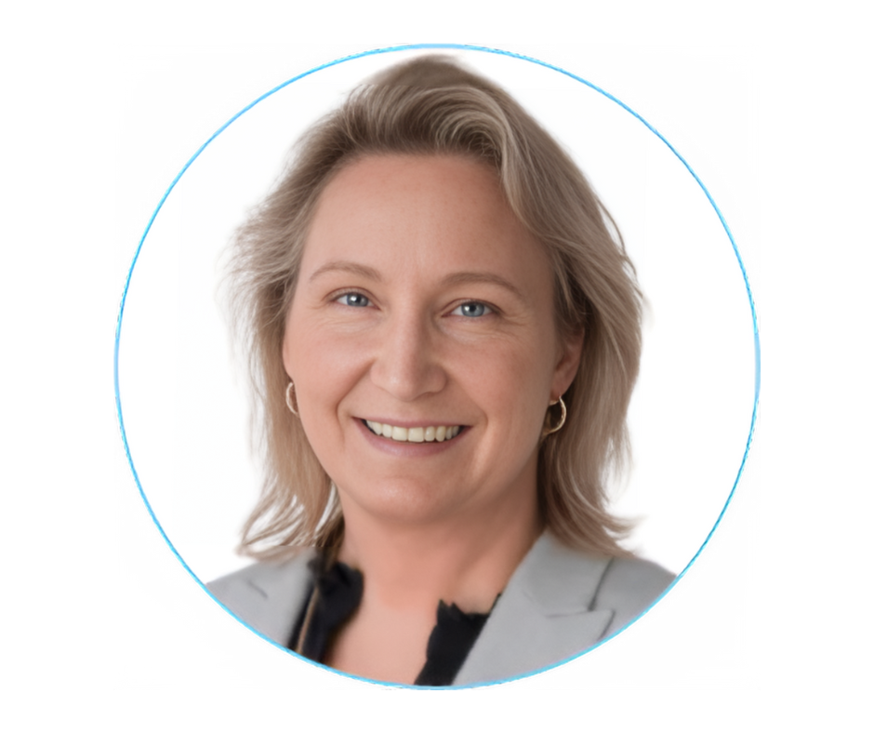
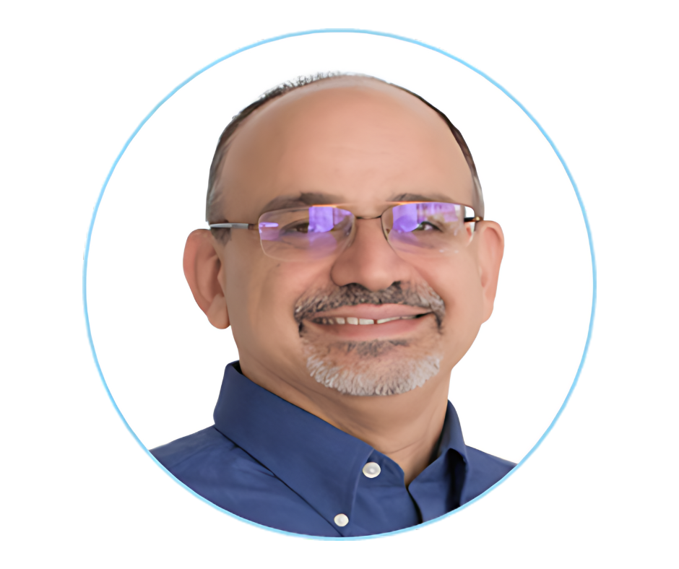



Your team
Leslie Sommer
Rob rousseau
Talia hiebert
Client Care Specialist
Office Manager
Client Support Coordinator
604.385.1164 ext. 220
leslie@rightdirectionfinancial.ca
604.385.1164 ext. 221
rob@rightdirectionfinancial.ca
604.385.1164 ext. 224
talia@rightdirectionfinancial.ca

Slide 34

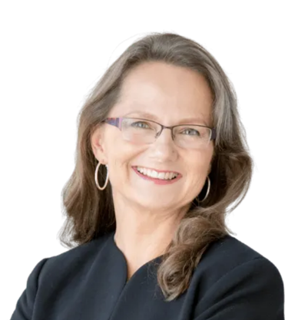




thank you! “If there are other people in your life who would also benefit from our comprehensive financial planning services, please feel free to share my contact information with them. It would be my pleasure to help them reach their financial goals.”
Laura Chanin CFP®
604.385.1164 Ex 222 laura@rightdirectionfinancial.ca

Slide 35
The End

Slide 36
meeting Summary
internal
Meeting Notes:
5/1/24-

